Slide 1
Economic Statistics in the Modern Age
Assoc. Prof. Mojca Bavdaž (mojca.bavdaz@ef.uni-lj.si)
University of Ljubljana, School of Economics and Business
International Week, Prague, 20 – 23 January 2020

Slide 2
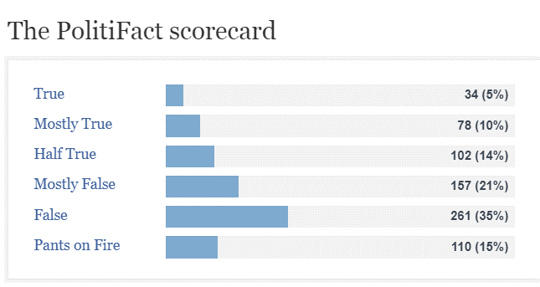

Slide 3
Highly unreliable economic & financial statistical data in Mexico ⇒ fin. crisis in 1994
Greece entered eurozone in 2001 ⇒ falsified budget deficit & public debt data
Argentina ⇒ falsified inflation rate (2008…)
Venezuela ⇒ no official statistics since 2015

Slide 4
1994: UN Fundamental Principles of Official Statistics
1995: IMF Special Data Dissemination Standard
2005: The European Statistics Code of Practice

Slide 5
European Statistics Code of Practice
Sets standards for developing, producing and disseminating European statistics
Quality dimensions:
Relevance
Accuracy & Reliability
Timeliness & Punctuality
Coherence & Comparability
Accessibility & Clarity

Slide 6
Measurement in economics
Economic phenomena are
complex,
changeable and
difficult to isolate and
they occur in a variable technical, legal, social and political context
(Malinvaud, 1997).

Slide 7
Concepts and their operationalization
Good weather
Inflation

Slide 8
Price of coffee
Yesterday: 1.30 EUR
Today: 1.50 EUR
If no change in quality ⇒ „Pure“ price change = inflation

Slide 9
If price stayed the same….
iPhone is a trademark of Apple Inc. The photos have not been authorized, sponsored, or otherwise approved by Apple Inc.
iPhonelife (7 January 2020). The Evolution of the iPhone: Every Model from 2007–2019 [digital image]. Retrieved from https://www.iphonelife.com/content/evolution-iphone-every-model-2007-2016

Slide 10
Complex relations between units for observation of economic phenomena
United Nations Statistics Division. Statistical units. [presentation]. Available at http://slideplayer.com/slide/6800744/

Slide 11
A survey from a quality perspective
Source: Groves et al. (2004). Survey Methodology. Hoboken: Wiley.

Slide 12
Data sources for official statistics
Primary data collection
(survey, census, electronic data exchange)
“Admin data”
“Big data”
Out of control

Slide 13
Not economic statistics data but anyway…

Slide 14
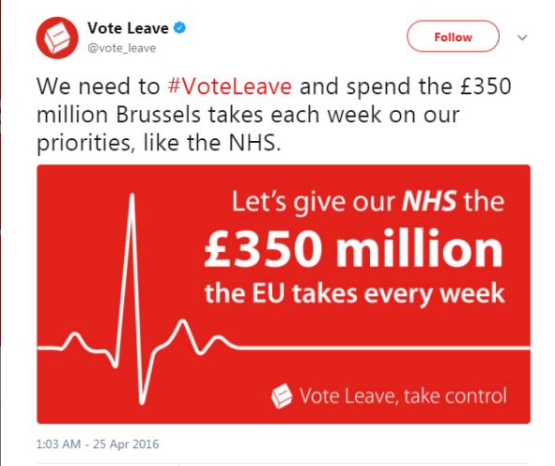
Use(r)s of official statistics

Slide 15
Way ahead
Standards
Measurement challenges
Integration of data sources
Visualizations & communication

