Slide 2
Value of Data in Business Processes
On intensive days students learned:
• How meaningful data can be recognized.
* Where it can be found!
* Internal and external sources of data.
* Valuable data.
• What possibilities does it give to the business?
• How to lead the data-analytics development process in businesses.
* Process steps.
* Digitalization's maturity levels in business.

Slide 3
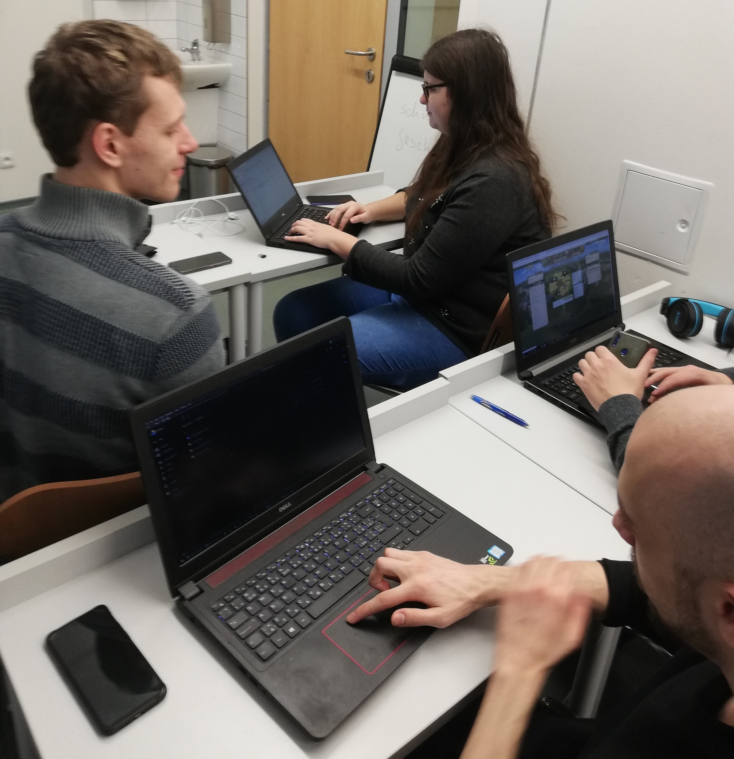
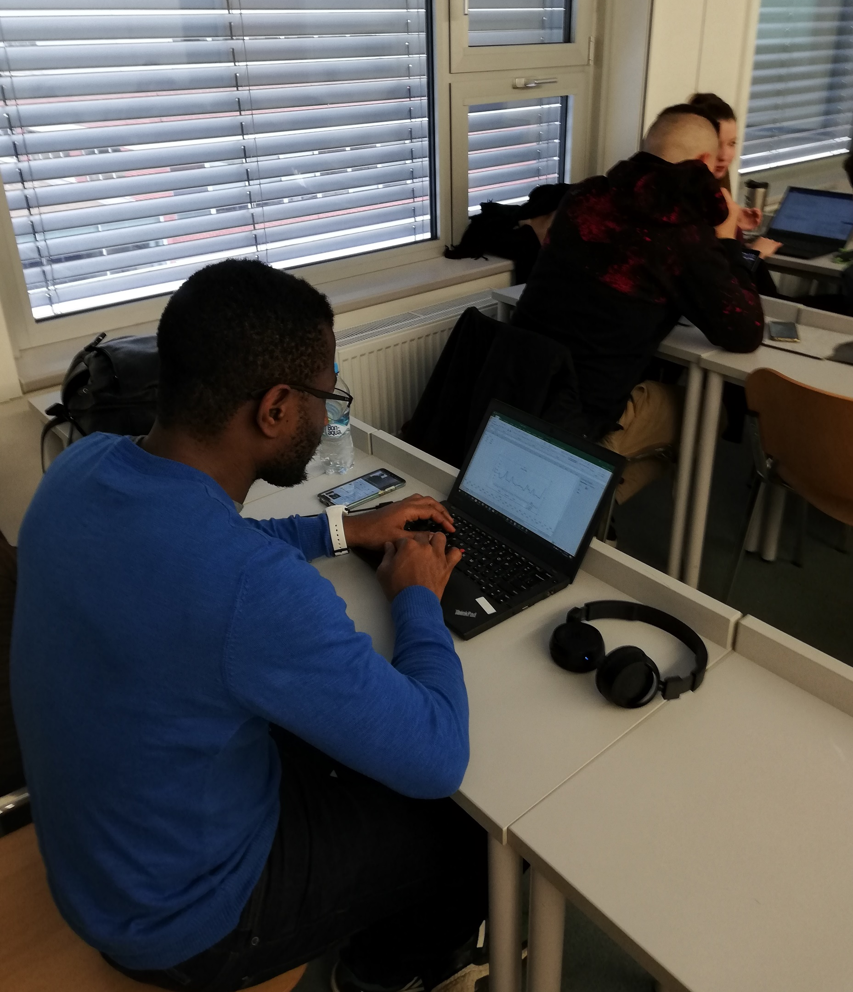
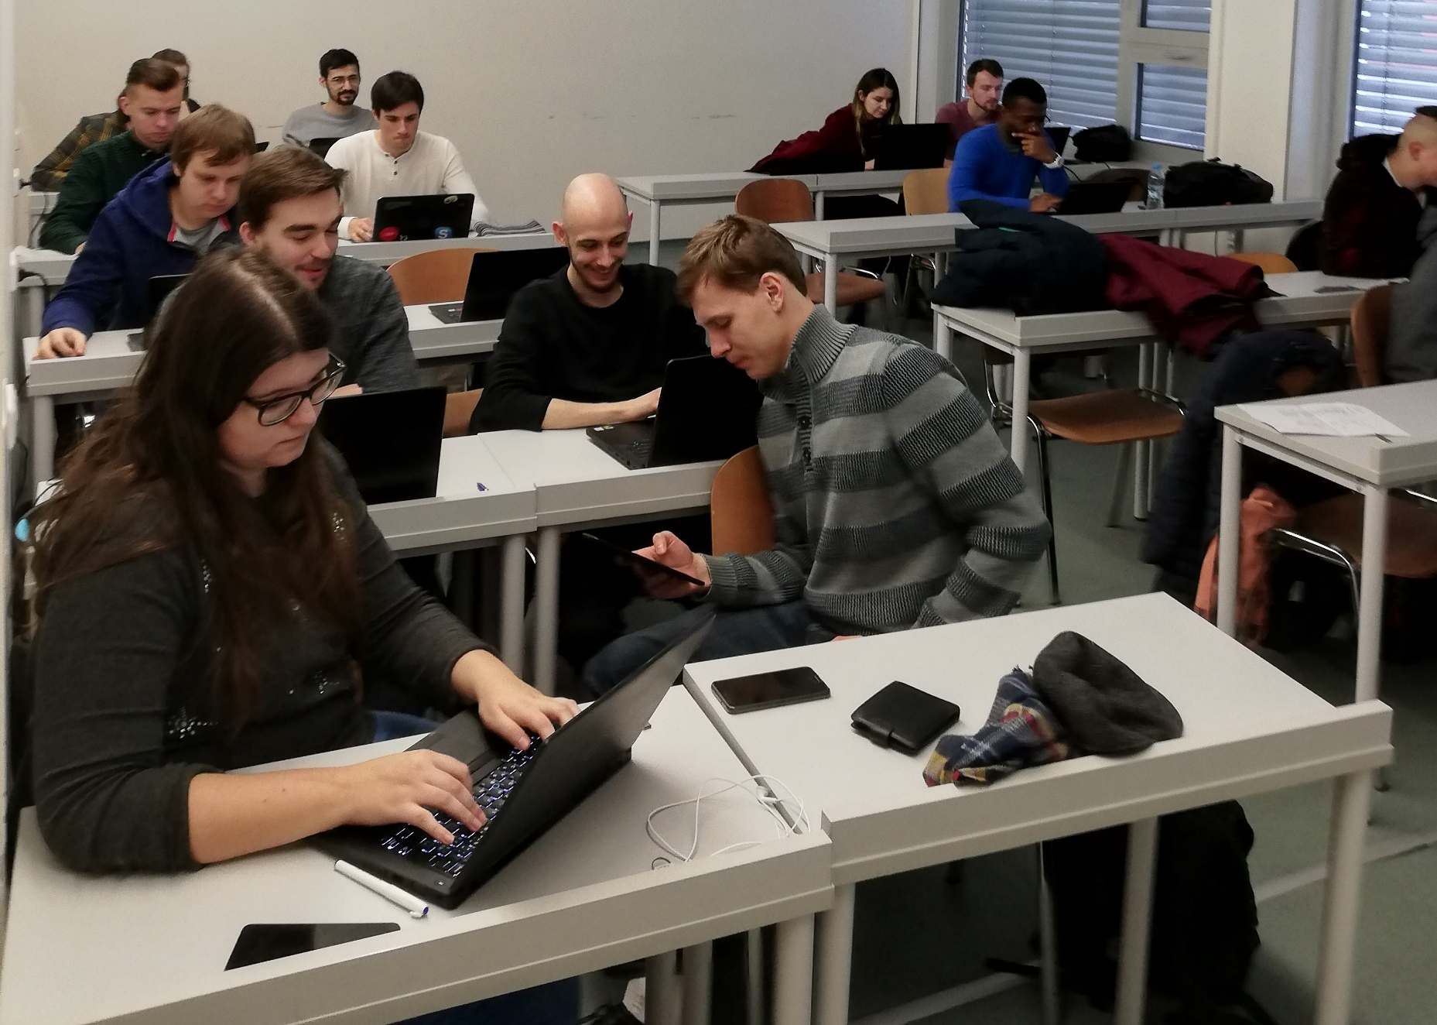
“Active and motivated group of students!”

Slide 4
Results
6 teams worked with their cases.
Teams wrote articles related to the main topic. * Possibility for digitalization of an existing Pizza restaurant. * Traditional tea shop business and insights that would impact sales. * Modern approaches to using data for online media.

